Slide 1
Design and Analysis of Algorithms
Noor ul Ain
National University of Computer and Emerging Sciences, Islamabad

Slide 2
Algorithm Characteristics
The necessary features of an algorithm:
Definiteness
  The steps of an algorithm must be precisely defined.
Effectiveness
  Individual steps are all do-able.
Finiteness
  It won’t take forever to produce the desired output for any input in the specified domain.
Output
  Information or data that goes out.

Slide 3
Algorithm Characteristics
Other important features of an algorithm:
Input.
  Information or data that comes in.
Correctness.
  Outputs correctly relate to inputs.
Generality.
  Works for many possible inputs.
Efficiency.
  Takes little time & memory to run.

Slide 4
Complexity Analysis
Want to achieve platform-independence
Use an abstract machine that uses steps of time and units of memory, instead of seconds or bytes
each elementary operation takes 1 step
each elementary instance occupies 1 unit of memory
Notes:
The next issue concerns units for measuring an algorithm’s running time. Of course, we can simply use some standard unit of time measurement—a second, or millisecond, and so on—to measure the running time of a program implementing the algorithm. There are obvious drawbacks to such an approach, however: dependence on the speed of a particular computer, dependence on the quality of a program implementing the algorithm and of the compiler used in generating the
machine code, and the difficulty of clocking the actual running time of the program. Since we are after a measure of an algorithm’s efficiency, we would like to
have a metric that does not depend on these extraneous factors.
The thing to do is to identify the most important operation of the algorithm, called the basic operation, the operation contributing the most to the total running time, and compute the number of times the basic operation is executed.

Slide 5
Standard Analysis Techniques
Constant time statements
Analyzing Loops
Analyzing Nested Loops
Analyzing Sequence of Statements
Analyzing Conditional Statements

Slide 6
Analysing an Algorithm
Simple statement sequence
  s₁; s₂; …. ; s_{k}
  Basic Step = 1 as long as k is constant
Simple loops
  for(i=0; i<n; i++) { s; }
  where s is Basic Step = 1
  Basic Steps : n
Nested loops
  for(i=0; i<n; i++)
  for(j=0; j<n; j++) { s; }
  Basic Steps : n²

Slide 7
Analysing an Algorithm
Loop index depends on outer loop index
  for(j=0;j<=n;j++)
  for(k=0;k<j;k++){
  s;
  }
  Inner loop executed
    1, 2, 3, …., n times
  Basic Steps : n²
n
n(n+1)
Σ i =
i=1
2

Slide 8
Analysing an Algorithm
// Input: int A[N], array of N integers
// Output: Sum of all numbers in array A
int Sum(int A[], int N)
{
int s=0;
for (int i=0; i< N; i++)
s = s + A[i];
return s;
}
How should we analyse this?

Slide 9
Analysing an Algorithm
// Input: int A[N], array of N integers
// Output: Sum of all numbers in array A
int Sum(int A[], int N){
int s=0;
for (int i=0; i< N; i++)
s = s + A[i];
return s;
}
1
2
3
4
5
1,2,8: Once
3,4,5,6,7: Once per each iteration
of for loop, N iteration
Total: 5N + 3
The complexity function of the
algorithm is : f(N) = 5N +3
6
7
8

Slide 10
Constant time statements
Simplest case: O(1) time statements
Assignment statements of simple data types
int x = y;
Arithmetic operations:
x = 5 * y + 4 - z;
Array referencing:
A[j] = 5;
Most conditional tests:
if (x < 12) ...

Slide 11
Analyzing Loops
Any loop has two parts:
  How many iterations are performed?
  How many steps per iteration?
  int sum = 0,j;
  for (j=0; j < N; j++)
  sum = sum +j;

Slide 12
Analyzing Loops
Any loop has two parts:
  How many iterations are performed?
  How many steps per iteration?
  int sum = 0,j;
  for (j=0; j < N; j++)
  sum = sum +j;
  Loop executes N times (0..N-1)
  O(1) steps per iteration
Total time is N * O(1) = O(N*1) = O(N)

Slide 13
Class Activity
  int sum = 0;
  for (i=1;i<n; i=i+2)
  sum = sum +i;

Slide 14
Class Activity
  int sum = 0,j;
  for (i=1;i<n; i=i+2)
  sum = sum +i;
  F(n)= n/2;
  F(n)= O(n)

Slide 15
Analyzing Loops
What about this for loop?
    int sum =0, j;
    for (j=0; j < 100; j++)
    sum = sum +j;
Loop executes 100 times
O(1) steps per iteration
Total time is 100 * O(1) = O(100 * 1) = O(100) = O(1)

Slide 16
Analyzing Nested Loops
Treat just like a single loop and evaluate each level of nesting as needed:
  int j,k;
  for (j=0; j<n; j++)
  for (k=0; k<n; k++)
  sum += k+j;

Slide 17
Analyzing Nested Loops
Treat just like a single loop and evaluate each level of nesting as needed:
  int j,k;
  for (j=0; j<n; j++)
  for (k=0; k<n; k++)
  sum += k+j;
n+1 times
(n) * n+1 times
n * n times
F(n)= 2n²+2n+1
F(n)= O(n²)

Slide 18
Analyzing Nested Loops
Treat just like a single loop and evaluate each level of nesting as needed:
  int j,k;
  for (j=0; j<n; j++)
  for (k=0; k<n; k++)
  sum += k+j;
Start with outer loop:
  How many iterations? N
  How much time per iteration? Need to evaluate inner loop
Inner loop uses O(N) time
Total time is N * O(N) = O(N*N) = O(N²)

Slide 19
Analyzing Nested Loops
Treat just like a single loop and evaluate each level of nesting as needed:
      int j,k;
      for (j=0; j<N; j++)
      for (k=N; k>0; k--)
      sum += k+j;
?

Slide 20
Analyzing Nested Loops
Treat just like a single loop and evaluate each level of nesting as needed:
      int j,k;
      for (j=0; j<N; j++)
      for (k=N; k>0; k--)
      sum += k+j;
Start with outer loop:
  How many iterations? N
  How much time per iteration? Need to evaluate inner loop
Inner loop uses O(N) time
Total time is N * O(N) = O(N*N) = O(N²)

Slide 21
Analyzing Nested Loops
Treat just like a single loop and evaluate each level of nesting as needed:
      int j,k;
      for (j=0; j<N; j++)
      for (k=N; k>0; k--)
      sum += k+j;
Start with outer loop:
  How many iterations? N
  How much time per iteration? Need to evaluate inner loop
Inner loop uses O(N) time
Total time is N * O(N) = O(N*N) = O(N²)

Slide 22
Analyzing Nested Loops
What if the number of iterations of one loop depends on the counter of the other?
  int j,k;
  for (j=0; j < N; j++)
  for (k=0; k < j; k++)
  sum += k+j;
Analyze inner and outer loop together:
Number of iterations of the inner loop is:
0 + 1 + 2 + ... + (N-1) = O(N²)

Slide 23
Analyzing Sequence of Statements
    for (j=0; j < N; j++)
    for (k =0; k < j; k++)
    sum = sum + j*k;
    for (l=0; l < N; l++)
    sum = sum -l;
    cout<<“Sum=”<<sum;

Slide 24
Analyzing Sequence of Statements
For a sequence of statements, compute their complexity functions individually and add them up
    for (j=0; j < N; j++)
    for (k =0; k < j; k++)
    sum = sum + j*k;
    for (l=0; l < N; l++)
    sum = sum -l;
    cout<<“Sum=”<<sum;
Total cost is O(N²) + O(N) +O(1) = O(N²)
O(N²)
O(N)
O(1)
SUM RULE

Slide 25
Analysing an Algorithm
Loop index doesn’t vary linearly
  i = 1;
  while ( i < n ) {
  s;
  i = 2 * i;
  }

Slide 26
Analysing an Algorithm
Loop index doesn’t vary linearly
  i = 1;
  while ( i < n ) {
  s;
  i = 2 * i;
  }
  i takes values 1, 2, 4, … until it exceeds n

Slide 27
i
1
1x2=2
2x2=2²
2²x2=2³
.
.
.
2^{k}

Slide 28
i
1
1x2=2
2x2=2²
2²x2=2³
.
.
.
2^{k}
Assume
i>=n
i=2^{k}
2^{k} =n
K= log₂(n)

Slide 29
Analyzing Conditional Statements
What about conditional statements such as
        if (condition)
        statement1;
        else
        statement2;
where statement1 runs in O(N) time and statement2 runs in O(N²) time?
We use "worst case" complexity: among all inputs of size N, that is the maximum running time?
The analysis for the example above is O(N²)

Slide 30
Analysing an Algorithm
Growth of 5n+3
Estimated running time for different values of N:
N = 10 => 53 steps
N = 100 => 503 steps
N = 1,000 => 5003 steps
N = 1,000,000 => 5,000,003 steps
As N grows, the number of steps grow in linear proportion to N for this function “Sum”

Slide 31
Some helpful mathematics
1 + 2 + 3 + 4 + … + N
  N(N+1)/2 = N²/2 + N/2 is O(N²)
N + N + N + …. + N (total of N times)
  N*N = N² which is O(N²)
1 + 2 + 4 + … + 2^{N}
  2^{N+1} – 1 = 2 x 2^{N} – 1 which is O(2^{N} )

Slide 32
10⁶ instructions/sec, runtimes
N | O(log N) | O(N) | O(N log N) | O(N²)
10 | 0.000003 | 0.00001 | 0.000033 | 0.0001
100 | 0.000007 | 0.00010 | 0.000664 | 0.1000
1,000 | 0.000010 | 0.00100 | 0.010000 | 1.0
10,000 | 0.000013 | 0.01000 | 0.132900 | 1.7 min
100,000 | 0.000017 | 0.10000 | 1.661000 | 2.78 hr
1,000,000 | 0.000020 | 1.0 | 19.9 | 11.6 day
1,000,000,000 | 0.000030 | 16.7 min | 18.3 hr | 318 centuries

Slide 33
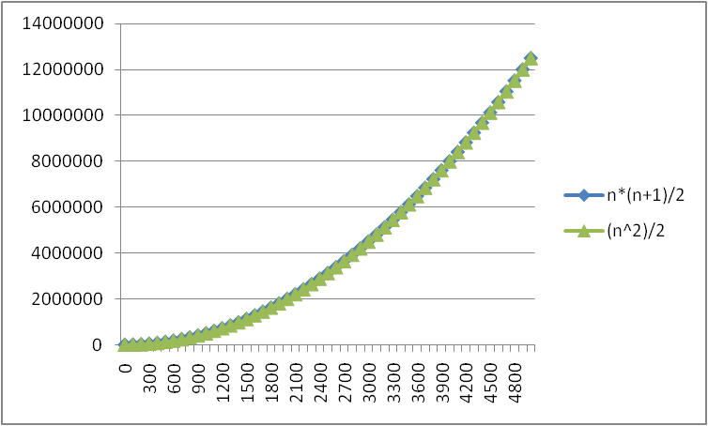
No Need To Be So Exact
Constants do not matter
Consider 6N² and 20N²
When N >> 20, the N² is what is driving the function's increase
Lower-order terms are also less important
N*(N+1)/2 vs.
just N²/2
The linear term is
inconsequential
We need a better notation for performance that focuses on the dominant terms only

Slide 34
What Dominates in Previous Example?
What about the +3 and 5 in 5N+3?
As N gets large, the +3 becomes insignificant
5 is inaccurate, as different operations require varying amounts of time and also does not have any significant importance
What is fundamental is that the time is linear in N.
Asymptotic Complexity: As N gets large, concentrate on the highest order term:
Drop lower order terms such as +3
Drop the constant coefficient of the highest order term i.e. N
Asymptotic Complexity: As N gets large, concentrate on the highest order term:

Slide 35
Asymptotic Complexity
The 5N+3 time bound is said to "grow asymptotically" like N
This gives us an approximation of the complexity of the algorithm
Ignores lots of (machine dependent) details, concentrate on the bigger picture

Slide 36
Asymptotic Analysis
Asymptotic analysis is an analysis of algorithms that focuses on
  Analyzing problems of large input size
  Consider only the leading term of the formula
  Ignore the coefficient of the leading term

Slide 37
Comparing Functions: Asymptotic Notation
Big Oh Notation: Upper bound
Omega Notation: Lower bound
Theta Notation: Tighter bound

Slide 38
Big-Oh Rules
If is f(n) a polynomial of degree d, then f(n) is O(n^{d}), i.e.,
  Drop lower-order terms
  Drop constant factors
Use the smallest possible class of functions
  Say “2n is O(n)” instead of “2n is O(n²)”
Use the simplest expression of the class
  Say “3n + 5 is O(n)” instead of “3n + 5 is O(3n)”

Slide 39
Big-Oh Notation
Given two functions f(n) & g(n) for input n, we say f(n) is in O(g(n) ) iff there exist positive constants c and n₀ such that
f(n) ≤ c g(n) for all n ≥ n₀
Basically, we want to find a
function g(n) that is eventually
always bigger than f(n)
g
f
n₀
n

Slide 40
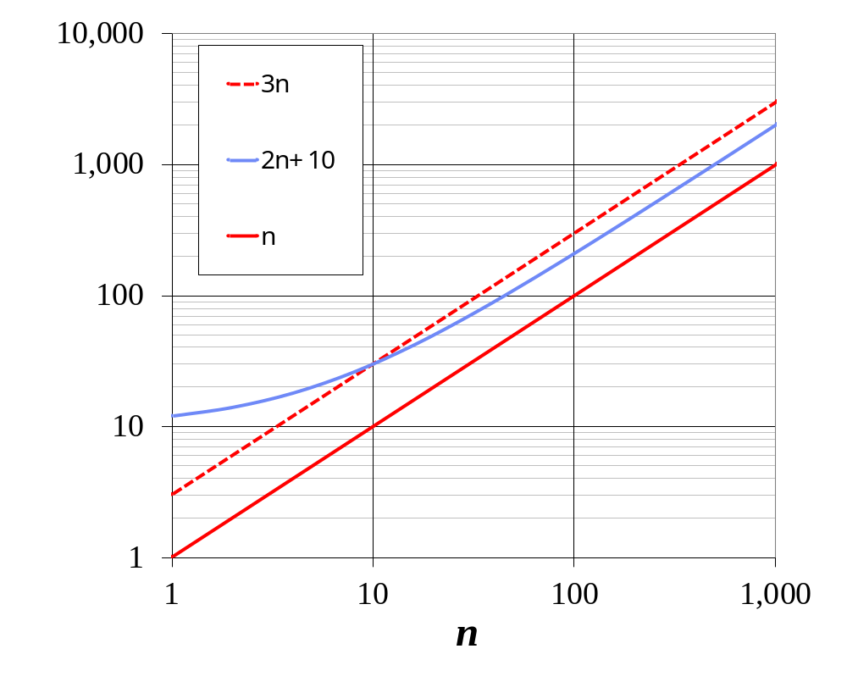
Big-Oh Notation (§3.4)
Given functions f(n) and g(n), we say that f(n) is O(g(n)) if there are positive constants
c and n₀ such that
f(n) ≤ cg(n) for n ≥ n₀
Example: 2n + 10 is O(n)
  2n + 10 ≤ cn
  (c − 2) n ≥ 10
  n ≥ 10/(c − 2)
  Pick c = 3 and n₀ = 10

Slide 41
Showing Order Briefly …
Show 10N² + 15N is O(N²)
.

Slide 42
Showing Order Briefly …
Show 10N² + 15N is O(N²)
Break into terms.
10N² < 10N²
15N < 15N² for N > 1 (Now add)
10N² + 15N < 10N² + 15N² for N > 1
10N² + 15N < 25N² for N > 1
c = 25, N₀ = 1
Note, the choices for c and N₀ are not unique.

Slide 43
The Gist of Big-Oh
Take functions f(n) & g(n), consider only the most significant term and remove constant multipliers:
  5n+3 → n
  7n+.5n²+2000 → n²
  300n+12+nlogn → n log n
Then compare the functions; if f(n) ≤ g(n), then f(n) is in O(g(n))

Slide 44
Big Oh Notation
If f(N) and g(N) are two complexity functions, we say
f(N) = O(g(N))
(read "f(N) as order g(N)", or "f(N) is big-O of g(N)")
if there are constants c and N₀ such that for N > N₀,
f(N) ≤ c * g(N)
for all sufficiently large N.
*big-O-Upper bound

Slide 45
Comparing Functions
As inputs get larger, any algorithm of a smaller order will be more efficient than an algorithm of a larger order
0.05 N² = O(N²)
3N = O(N)
Time (steps)
N = 60
Input (size)

Slide 46

Big Omega Notation

Slide 47

Big Theta Notation

Slide 48
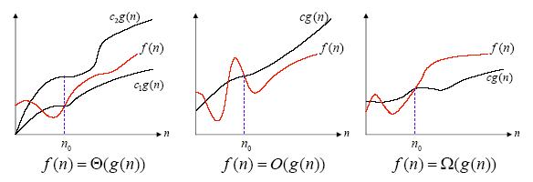
Asymptotic notation
Example:
  f(n) = 3n⁵+n⁴ = Θ(n⁵)

Slide 49
Polynomial and Intractable Algorithms
Polynomial Time complexity
  An algorithm is said to be polynomial if it is
  O( n^{d} ) for some integer d
  Polynomial algorithms are said to be efficient
    They solve problems in reasonable times!
Intractable algorithms
  Algorithms for which there is no known polynomial time algorithm
  We will come back to this important class later

Slide 50
Asymptotic order of growth
A way of comparing functions that ignores constant factors and small input sizes
O(g(n)): class of functions f(n) that grow no faster than g(n)
Θ(g(n)): class of functions f(n) that grow at same rate as g(n)
Ω(g(n)): class of functions f(n) that grow at least as fast as g(n)

Slide 51
>=
Ω(g(n)), functions that grow at least as fast as g(n)
=
Θ(g(n)), functions that grow at the same rate as g(n)
g(n)
<=
O(g(n)), functions that grow no faster than g(n)

Slide 52
Performance Classification
f(n) | Classification
1 | Constant: run time is fixed, and does not depend upon n. Most instructions are executed once, or only a few times, regardless of the amount of information being processed
log n | Logarithmic: when n increases, so does run time, but much slower. When n doubles, log n increases by a constant, but does not double until n increases to n². Common in programs which solve large problems by transforming them into smaller problems.
n | Linear: run time varies directly with n. Typically, a small amount of processing is done on each element.
n log n | When n doubles, run time slightly more than doubles. Common in programs which break a problem down into smaller sub-problems, solves them independently, then combines solutions
n² | Quadratic: when n doubles, runtime increases fourfold. Practical only for small problems; typically the program processes all pairs of input (e.g. in a double nested loop).
n³ | Cubic: when n doubles, runtime increases eightfold
2^{n} | Exponential: when n doubles, run time squares. This is often the result of a natural, “brute force” solution.

Slide 53
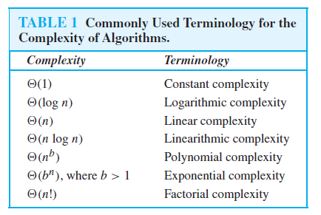

Slide 54
Size does matter
What happens if we double the input size N?
N log₂N 5N N log₂N N² 2^{N}
8 3 40 24 64 256
16 4 80 64 256 65536
32 5 160 160 1024 ~10⁹
64 6 320 384 4096 ~10¹⁹
128 7 640 896 16384 ~10³⁸
256 8 1280 2048 65536 ~10⁷⁶

Slide 55
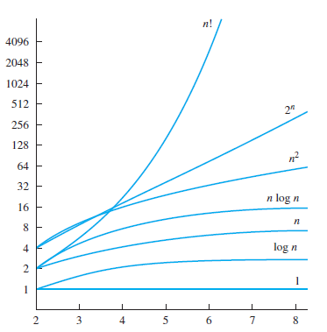
A Display of the Growth of Functions Commonly Used in Big-O Estimates

Slide 56
Typical Big O Functions – "Grades"
Function | Common Name
N! | factorial
2^{N} | Exponential
N^{d}, d > 3 | Polynomial
N³ | Cubic
N² | Quadratic
N N | N Square root N
N log N | N log N
N | Linear
N | Root - n
log N | Logarithmic
1 | Constant
Running
time grows
'quickly' with
more input.
Running
time grows
'slowly' with
more input.

Slide 57
Review of Three Common Sets
f(n) = O(g(n)) means c × g(n) is an Upper Bound on f(n)
f(n) = Ω(g(n)) means c × g(n) is a Lower Bound on f(n)
f(n) = Θ(g(n)) means c₁ × g(n) is an Upper Bound on f(n)
and c₂ × g(n) is a Lower Bound on f(n)
These bounds hold for all inputs beyond some threshold n₀.
Notes:
Asymptotic or Big-O notation.
O Omega Sigma

Slide 58
Properties of the O notation
Constant factors may be ignored
  ∀ k > 0, kf is O( f)
Higher powers grow faster
  n^{r} is O( n^{s}) if 0 ≤ r ≤ s
Fastest growing term dominates a sum
  If f is O(g), then f + g is O(g)
  eg an⁴ + bn³ is O(n⁴ )
Polynomial’s growth rate is determined by leading term
  If f is a polynomial of degree d,
  then f is O(n^{d})

Slide 59
Properties of the O notation
f is O(g) is transitive
  If f is O(g) and g is O(h) then f is O(h)
Product of upper bounds is upper bound for the product
  If f is O(g) and h is O(r) then fh is O(gr)
Exponential functions grow faster than powers
  n^{k} is O( b^{n} ) ∀ b > 1 and k ≥ 0
  e.g. n²⁰ is O( 1.05^{n})
Logarithms grow more slowly than powers
  log_{b}n is O( n^{k}) ∀ b > 1 and k > 0
  e.g. log₂n is O( n^{0.5})
Important!

Slide 60
Properties of the O notation
All logarithms grow at the same rate
  log_{b}n is O(log_{d}n) ∀ b, d > 1
Sum of first n r^{th} powers grows as the (r+1)^{th} power
  Σ k^{r} is Θ ( n^{r+1} )
  e.g. Σ k = is Θ ( n² )
n
k=1
n
n(n+1)
k=1
2

Slide 61
Order of growth
We usually consider one algorithm to be more efficient than another if its worst case running time has a lower order of growth.
  Due to constant factors and lower order terms, an algorithm whose running time has a higher order of growth might take less time for small inputs than an algorithm whose running time has a lower order of growth. But for large enough inputs, Θ ( n² ) algorithm, for example, will run more quickly in the worst case than Θ ( n³ ) algorithm

Slide 62
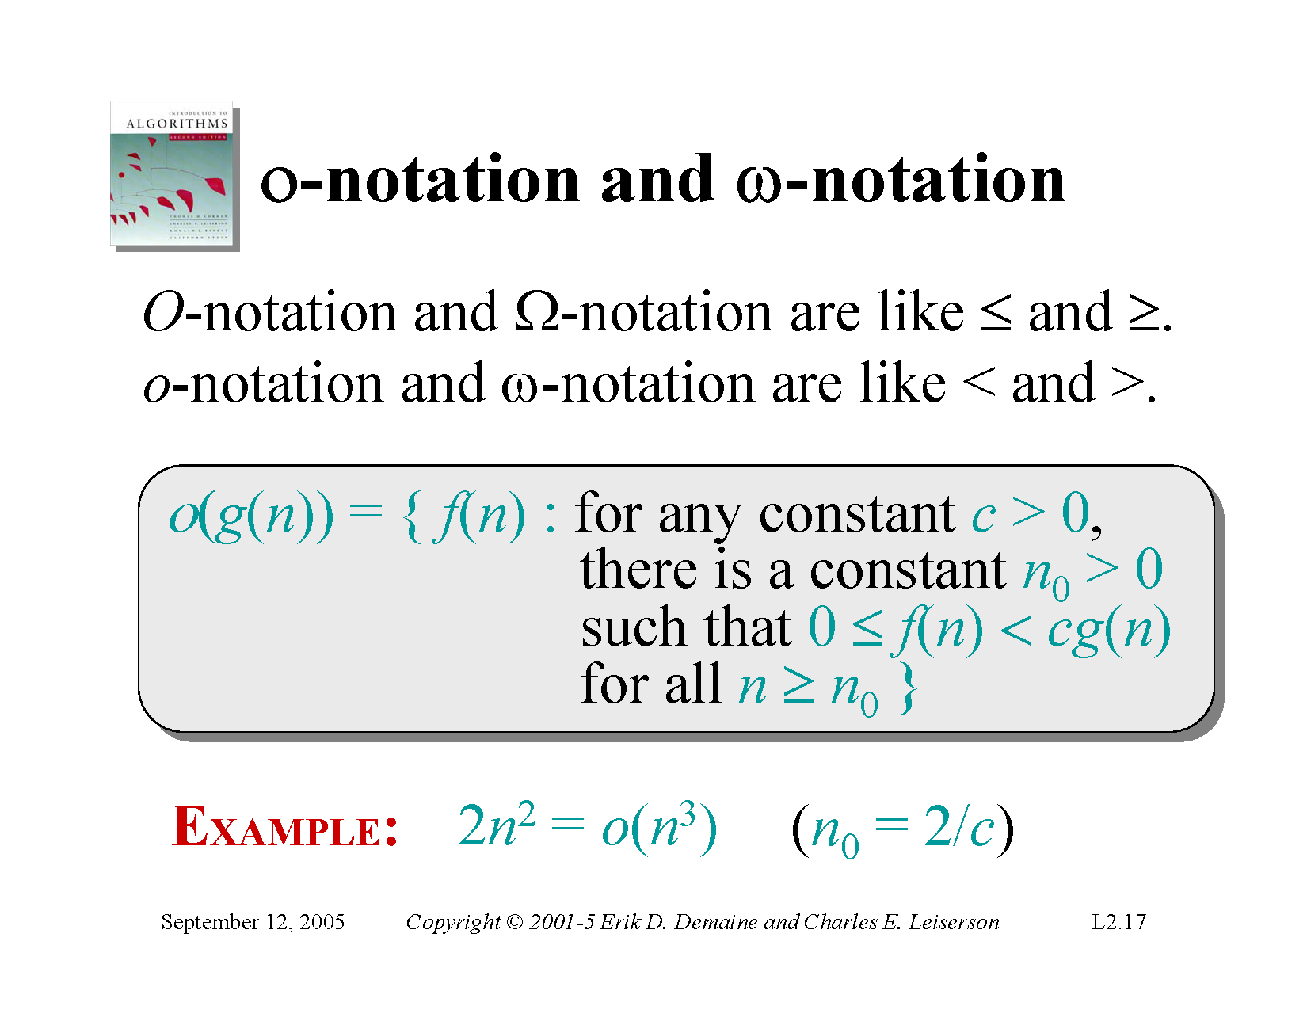

Slide 63
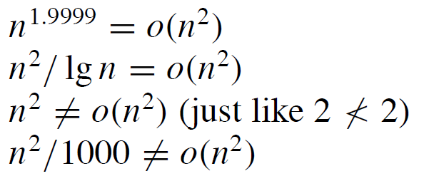
o-Notation
Examples

Slide 64


Slide 65

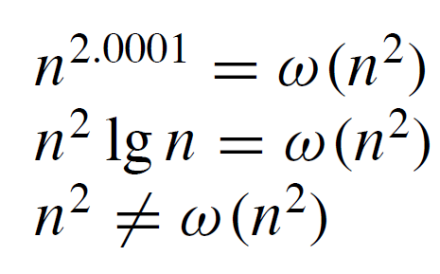
ω- notation

